Slide 1
Discussing organ donation with the Muslim family The effect of educational interventions on the opinions of Muslim and Black, Asian & Minority Ethnic (BAME) communities
Presenter: Omar Ali,
FY1, Royal Victoria Infirmary
Sameer Ahmed, Ayat Bashir, Saeed Ahmed, Sharif Al-Ghazal, Arshad Latif
Notes:
Bigger title, smaller photo.

Slide 2
Introduction
Chronic shortage of organ donors in the UK, especially in BAME groups
Muslims represent 1/3 of BAME population
Majority of Islamic scholarly opinion is in favour of OD
Religion & culture are decisive factors, making discussions in the Critical Care Unit challenging
Notes:
Median waiting times for adult kidney transplants for BAME patients are approximately 230 days longer than for White patients.

Slide 3
“Let’s Talk about Organ Donation”
Aims
Identify views & concerns of British Muslims on OD and address them
Hypotheses
A lack of awareness of established religious rulings is a barrier to registering
A focused educational intervention can improve willingness to register.

Slide 4
Methods
Panel of experts
clinicians (including Anaesthetics, Critical Care, Nephrology, Transplant surgery)
specialist nurses in OD
Islamic scholar specialising in OD
local Imams
Muslim patients awaiting/receiving a transplant.
Two public forums:
Newcastle
Nottingham
Advertised via
social media
local mosque announcements
promotional material in local community & healthcare centres.
Notes:
Similar interventions across the UK
Glasgow, Leeds, London, Manchester, Cardiff, Bradford
Promising results

Slide 5
Methods
OD from an Islamic perspective
OD process. Defining circulatory vs brain death
Common misconceptions
Anonymised live Q&A
UK law change to an opt-out system
Topics discussed
Patient experiences
Notes:
A bio-ethical discussion of OD from an Islamic perspective and a survey of contemporary fatawa

Slide 6
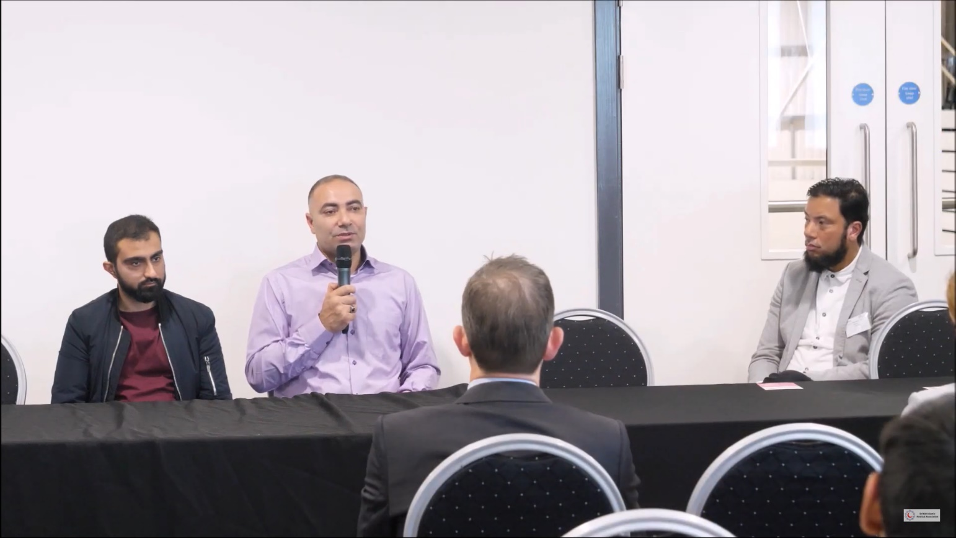
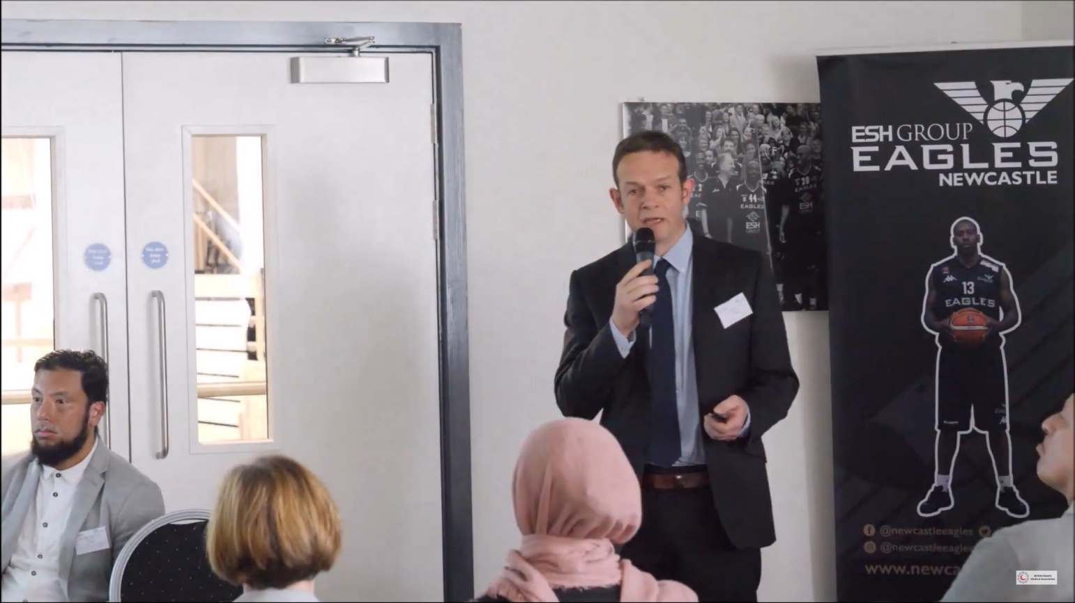
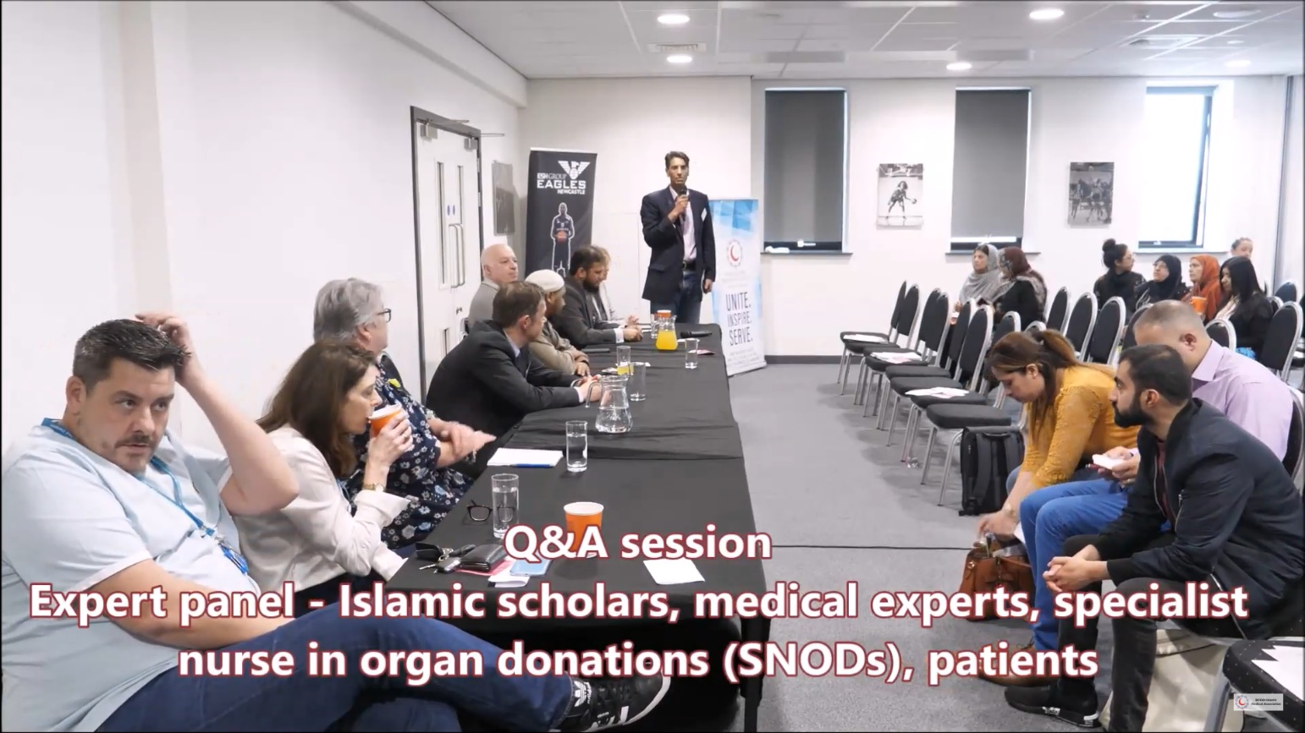

Slide 7
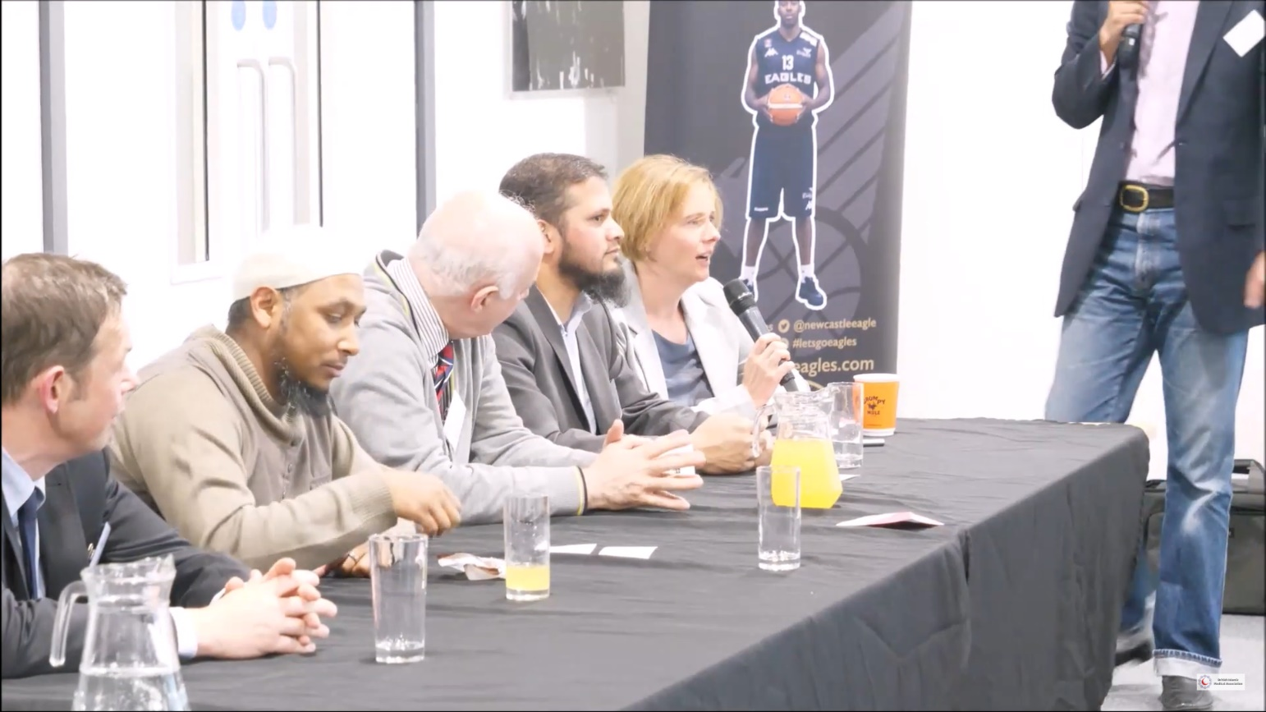
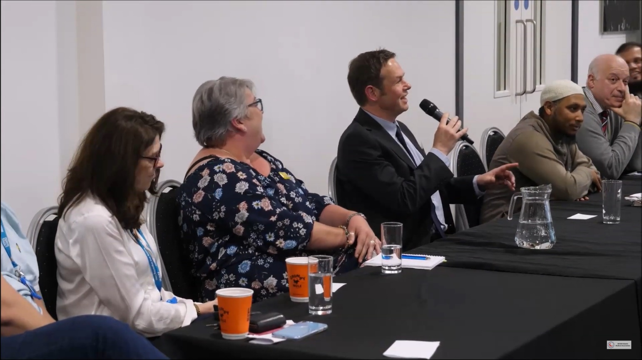
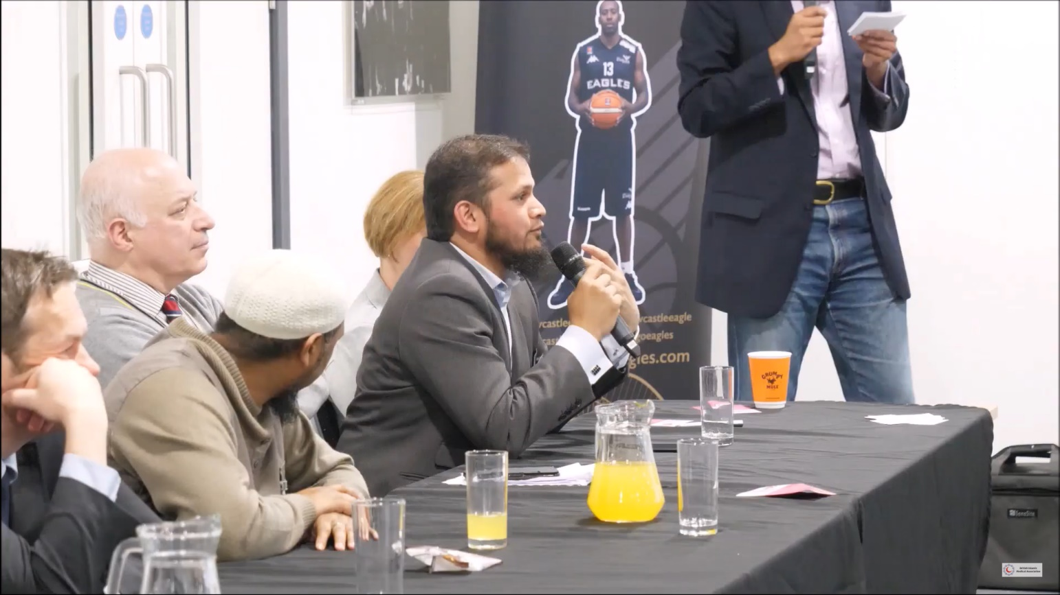

Slide 8
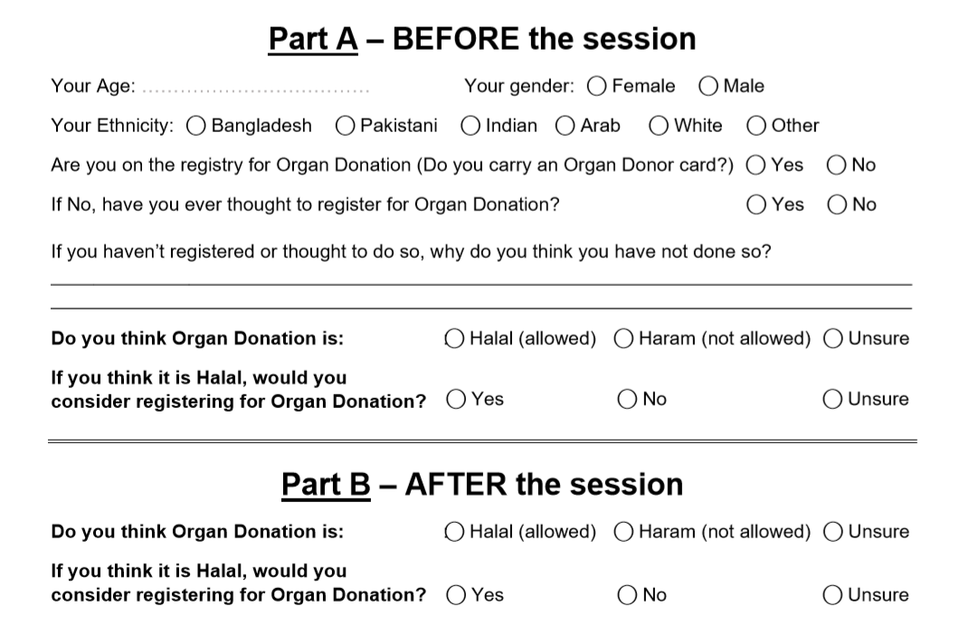

Slide 9
Methods
Primary outcomes
Views on religious permissibility
Willingness to register
Secondary outcomes
Relationship between demographics and opinions pre-intervention
Categorical variables presented as percentage values. Chi-squared analysis (p<0.05 deemed significant) via SPSS v26

Slide 10
Results
188 (74%) responses out of 240 attendees

Slide 12
Results
Cited barriers:
faith beliefs & views on religious permissibility (73%)
lack of knowledge on OD (21%)
family influence & reluctance to discuss OD (2%)
death & burial concerns (2%)
moral considerations (2%)

Slide 13
Results – primary outcomes
Notes:
Hypothesis 1 – religious uncertainty
60% initially unsure of religious permissibility
60% pre-intervention willing to register given permissibility
Religious uncertainty cited by 73% as barrier
Found in multiple other studies
However – religious uncertainty is not the only barrier – 20% post-intervention still unsure/unwilling to register even if OD were considered permissible
Hypothesis 2 – effect of educational intervention
Statistically significant shifts in opinion in favour of religious permissibility and willingness to register
Reduction in uncertainty

Slide 14
Results – secondary outcomes
No significant associations between subgroups and particular responses pre-intervention

Slide 15
Discussion
STRENGTHS
LIMITATIONS
Standard survey
Different geographical areas
Lack of randomisation
Unclear if shifts in opinion translate to long-term behavioural change

Slide 16
Conclusions
The majority of Islamic scholarly opinion is in favour of organ donation
Religious uncertainty is a major factor affecting donation decisions amongst British Muslims and BAME groups, though not the sole barrier
Given these are addressed, most Muslims can hold favourable views towards OD
Engaging local healthcare workers and faith leaders in future public health campaigning is valuable
There is substantial potential for OD amongst British Muslims

Slide 17
Contribution & Disclosures
Individual contribution: literature review, questionnaire design, data analysis and write-up
NHS Blood & Transplant (NHSBT) supported the Newcastle session in grant funding. NHSBT took no part in study design, collection, analysis or data interpretation.

Slide 18
References
Deedat S, Kenten C, Morgan M. What are effective approaches to increasing rates of organ donor registration among ethnic minority populations: a systematic review. BMJ Open. 2013;3(12):e003453.
Hayward C, Madill A. The meanings of organ donation: Muslims of Pakistani origin and white English nationals living in North England. Social Science & Medicine. 2003;57(3):389-401.
Karim A, Jandu S, Sharif A. A survey of South Asian attitudes to organ donation in the United Kingdom. Clin Transplant. 2013;27(5):757-63.
Khan Z, Randhawa G. Informing the UK's South Asian communities on organ donation and transplantation. Edtna erca j. 1999;25(1):12-4.
Long JC, Cunningham FC, Braithwaite J. Bridges. Brokers and boundary spanners in collaborative networks: a systematic review. BMC Health Services Research. 2013;13(1):158.
Morgan M, Sims J, Jain N, Sharma S, Randhawa G, Modi K. Who waits longest for a kidney? : Inequalities in access to kidney transplantation among Black and Asian Minority Ethnic (BAME) groups in the UK. British Journal of Renal Medicine. 2015;20:4-7.
Muslim Council of Britain. British Muslims in Numbers. Muslim Council of Britain; 2015 January 2015.
NHS Blood and Transplant. Organ donation and transplantation activity report 2018/19. 2019.
Office for National Statistics. Ethnicity and National Identity in England and Wales. 2011.
Oliver M, Woywodt A, Ahmed A, Saif I. Organ donation, transplantation and religion. Nephrology Dialysis Transplantation. 2010;26(2):437-44.
Sharif A, Jawad H, Nightingale P, Hodson J, Lipkin G, Cockwell P, et al. A quantitative survey of Western Muslim attitudes to solid organ donation. Transplantation. 2011;92(10):1108-14.
UK's Muslim Law Council approves organ transplants. J Med Ethics. 1996;22(2):99.

Slide 19
Thank you

